Slide 1
What Are British Values?
British values are ideas or thoughts which are considered important in helping us all to live happy, healthy and safe lives in modern British society.
Community Opportunities Responsibility Excellence

Slide 2
There are the five British Values?
Democracy
The belief in freedom and equality between all people. The British government works to ensure this happens.
The Rule of Law
The belief that rules and laws should be fair and help everyone to live safely and happily. Everyone working to follow the rules and laws.
Mutual Respect
The understanding that we should treat each other with respect and work together.
Tolerance of Those with Different Faiths and Beliefs
The understanding that we are all different and have different beliefs and values. This means accepting this.than anyone else.
Individual Liberty
The belief that all people have the right to live and express themselves as they choose, within the law. It involves the human rights of all being respected and protected.
Community Opportunities Responsibility Excellence

Slide 3
Why Are British Values Important?
British values encourage us all to live as rights-respecting citizens and celebrate the diversity of our nation.
They help everyone to have their rights respected and live happy, safe and healthy lives in which they have the opportunity to fulfil their potential.
Community Opportunities Responsibility Excellence

Slide 4
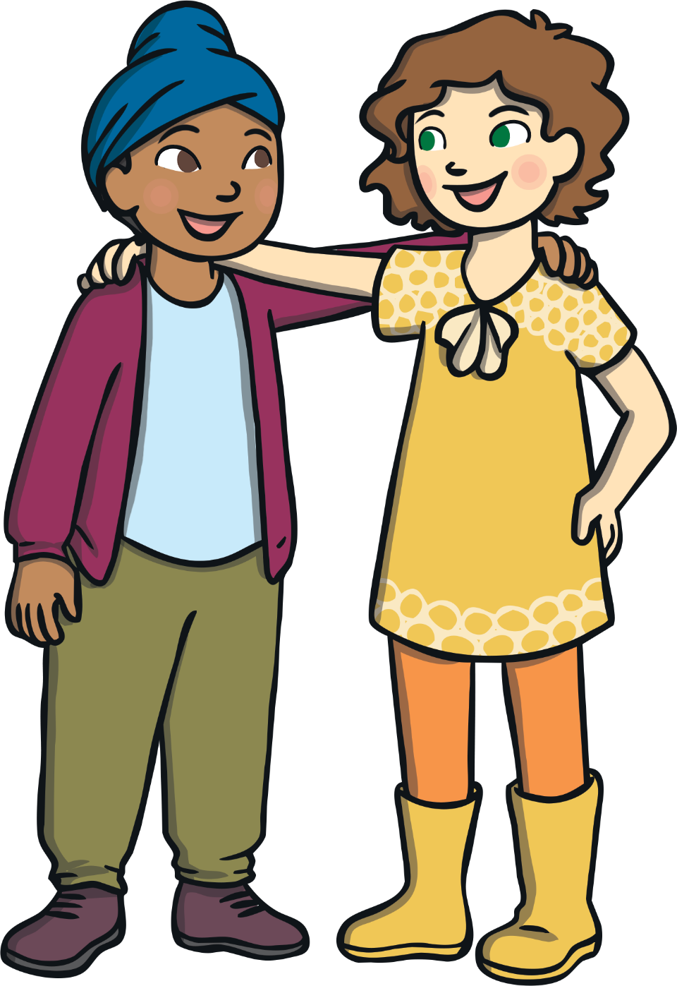
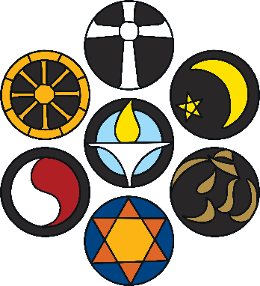
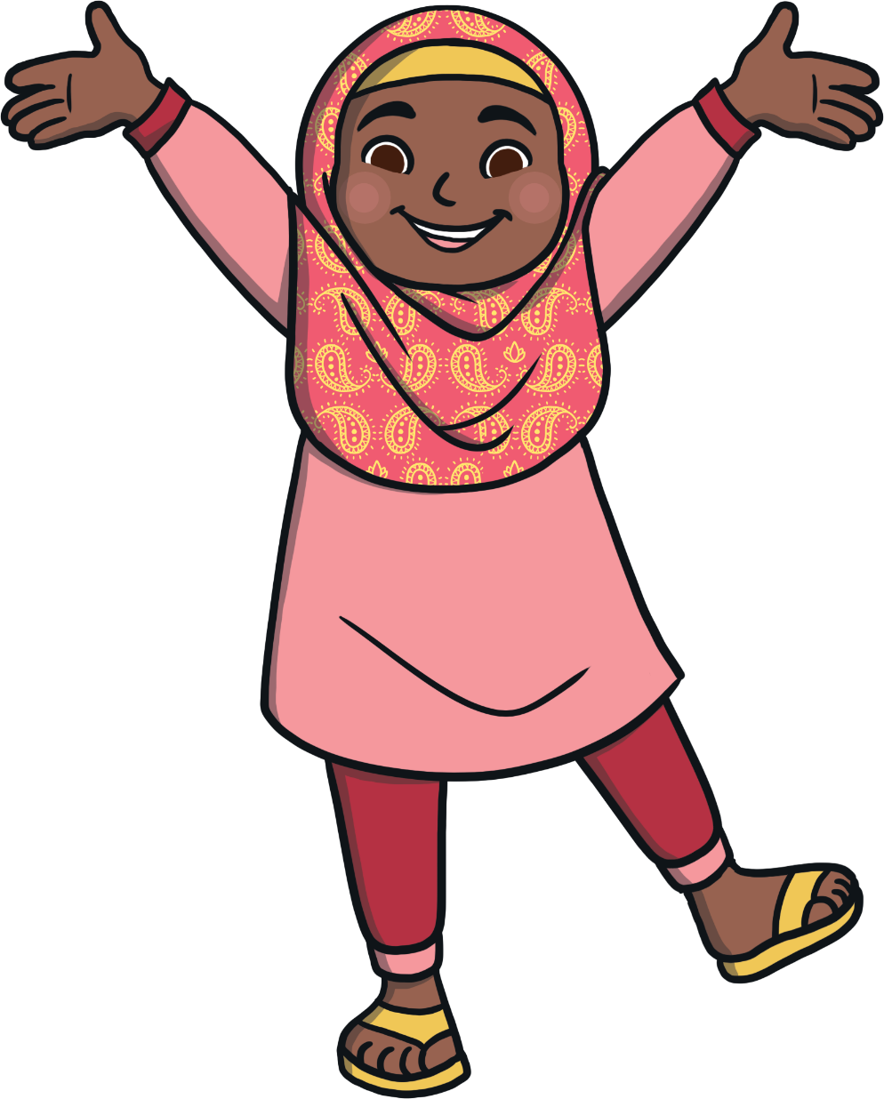
How Do British Values Help Us All?
Mutual respect and tolerance of those with different faiths or beliefs helps us to show empathy for and understand one another, especially those who are different from us. It helps to create happy and healthy communities.
Individual liberty helps us to have freedom of choice and respectfully express views and beliefs in a safe environment. It helps us to feel good about ourselves.
The rule of law helps us to know the difference between right and wrong, take responsibility for our actions and understand how following rules helps us to stay happy, healthy and safe.
Democracy helps us to have our voices heard, to be treated fairly and encourage fair processes and systems.
Community Opportunities Responsibility Excellence

Slide 5
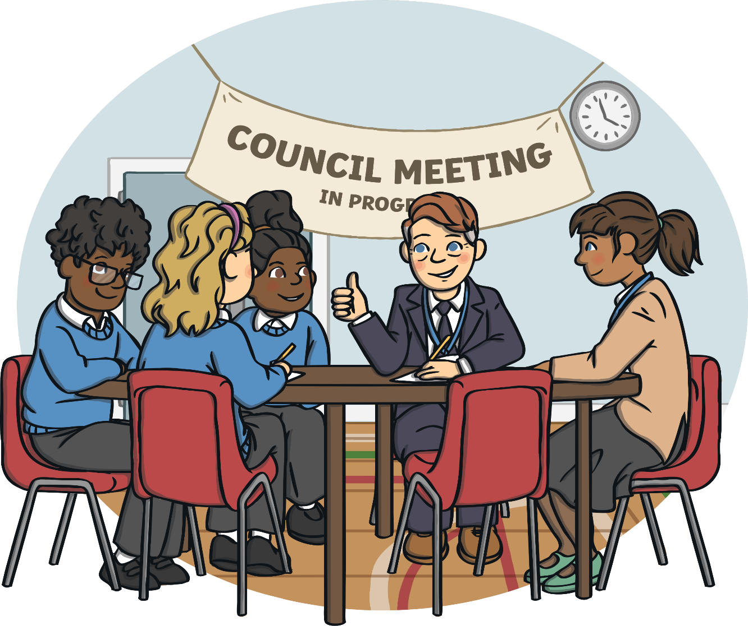
Democracy at Northstead
We can learn to promote British values in our daily lives. We can make choices which help to support these values.
We promote democracy in our Northstead community by listening to everyone and everyone having a voice.
Community Opportunities Responsibility Excellence

Slide 6
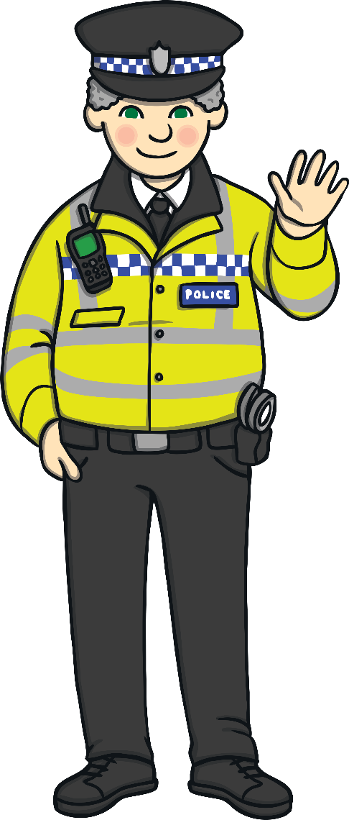
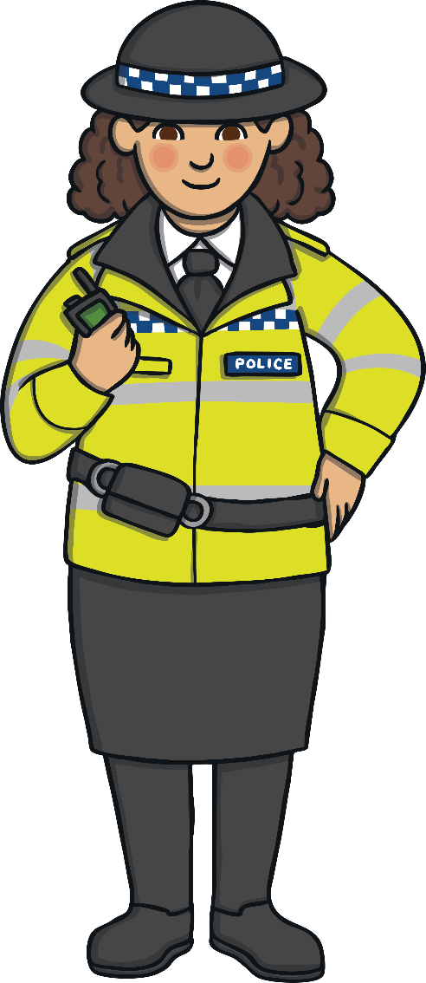
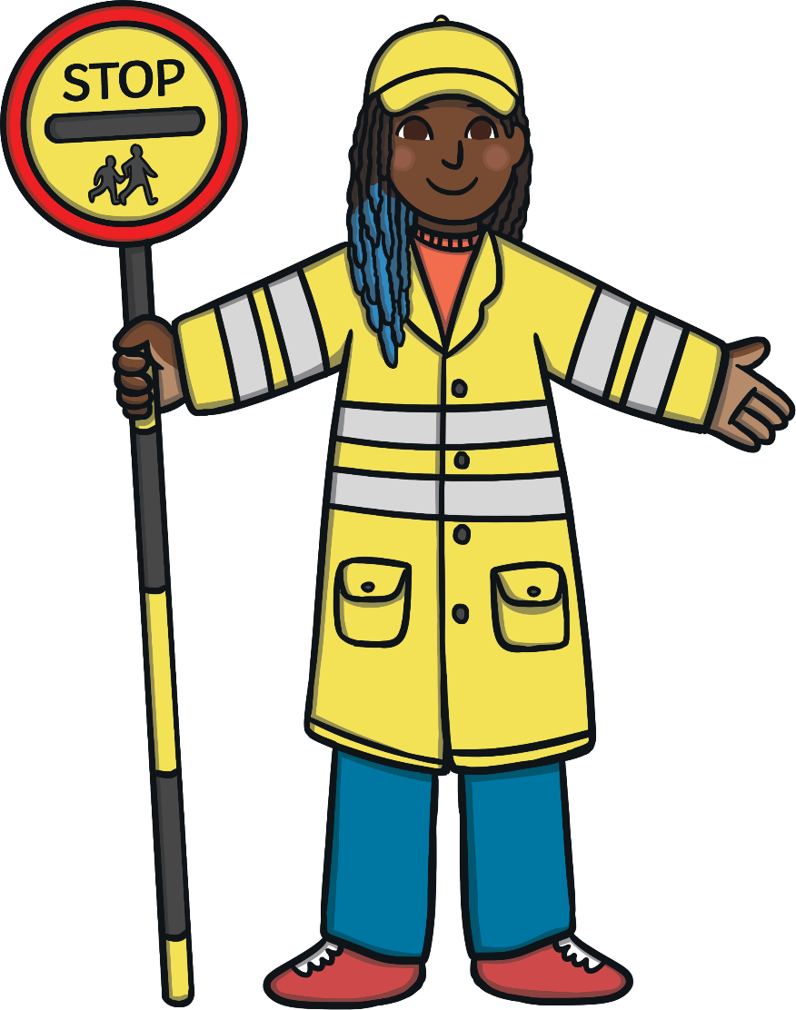
Rule of Law at Northstead
We promote the rule of law both at Northstead and in our community by following rules and laws and understanding why these are important.

Slide 7
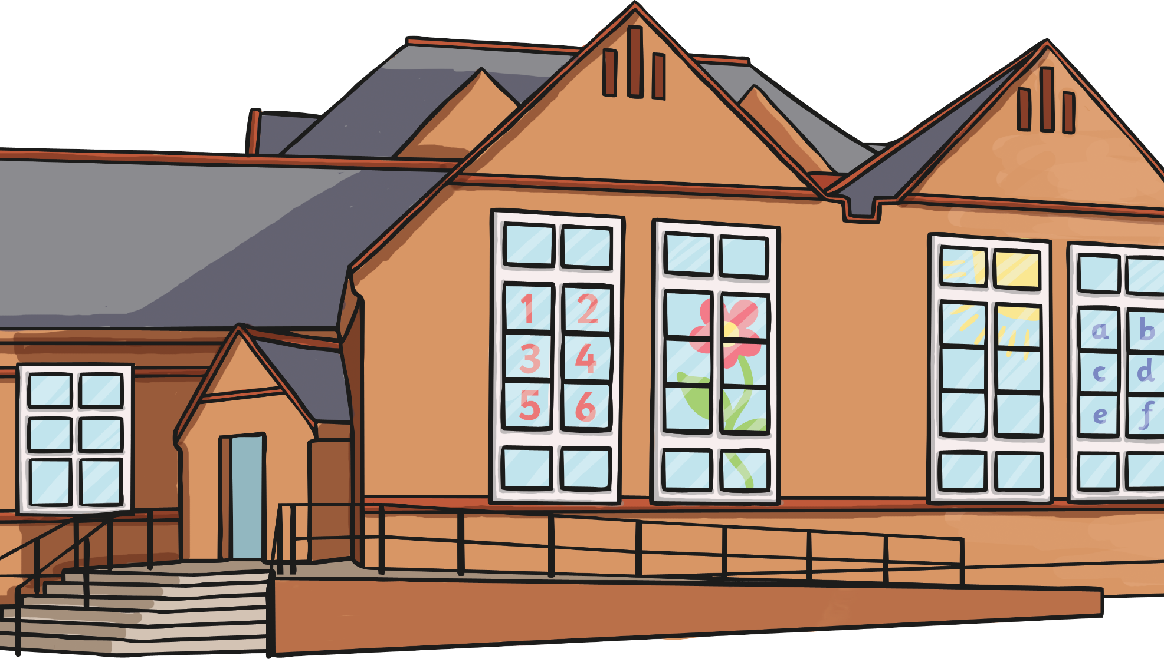
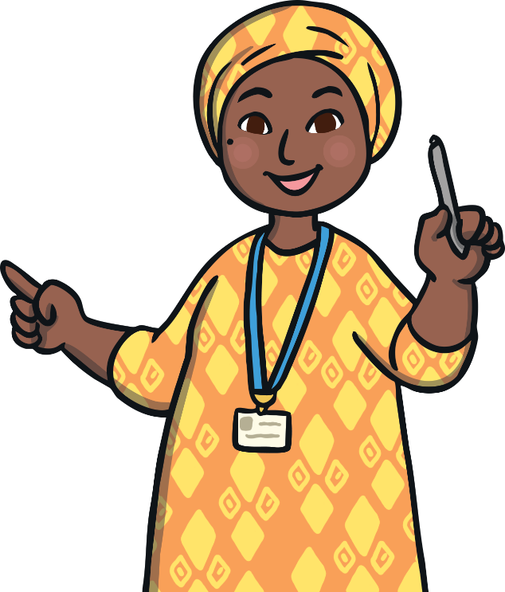
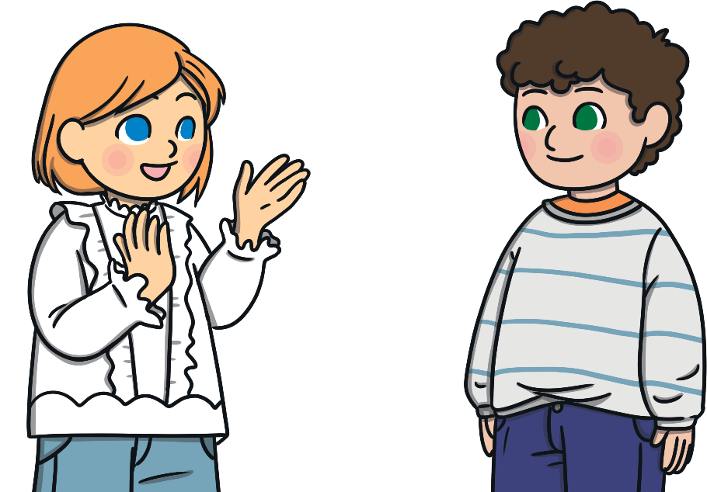
Individual Liberty at Northstead
We promote individual liberty in our school by being encouraged to make individual choices in a safe, supportive environment.

Slide 8
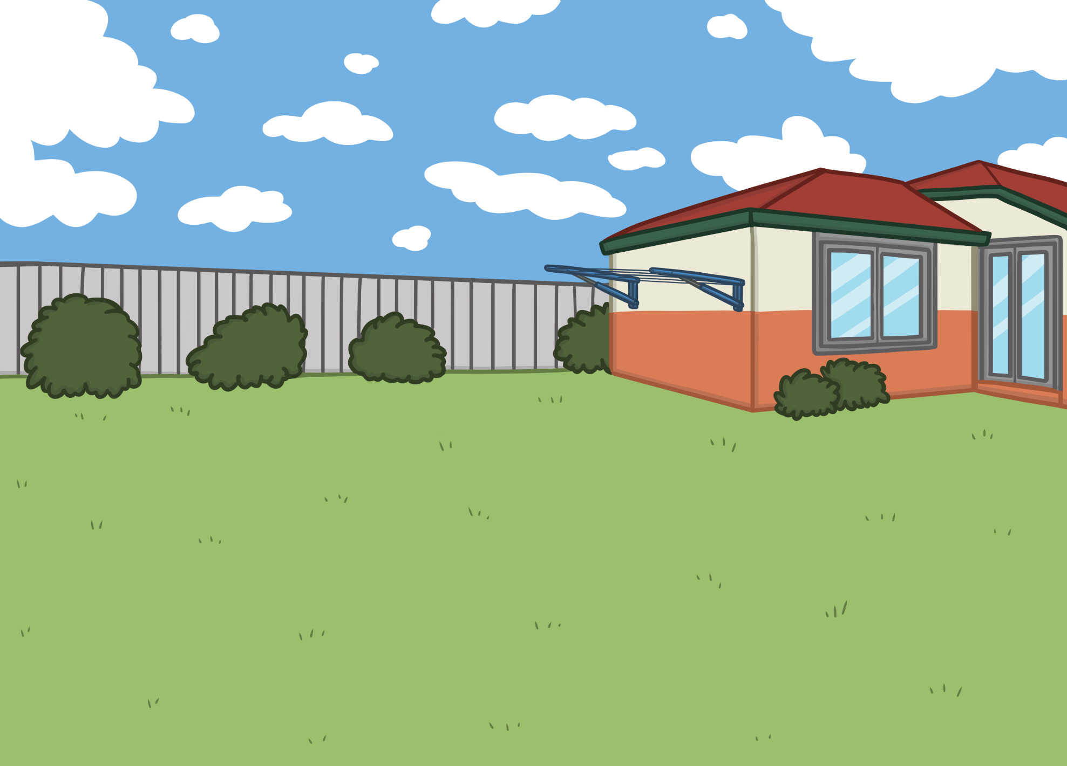
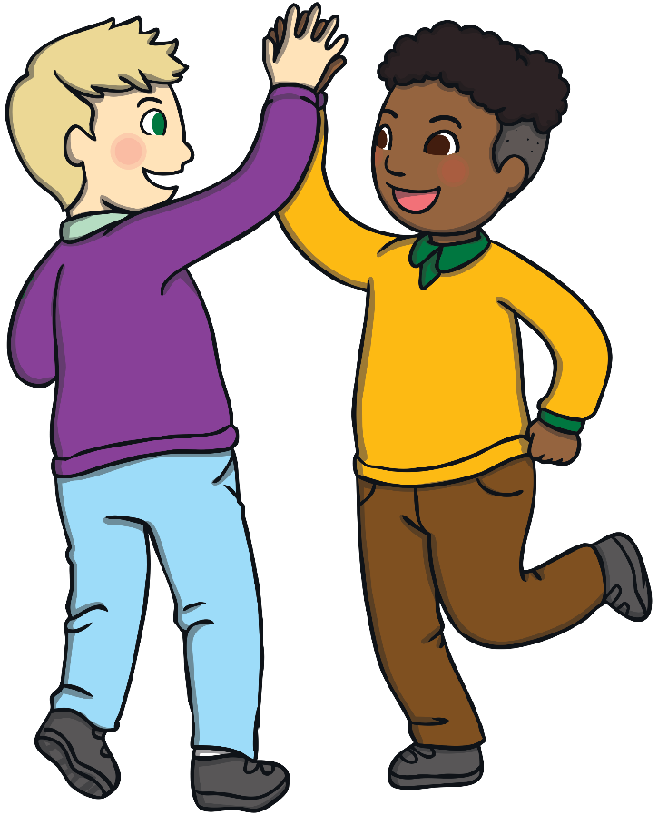
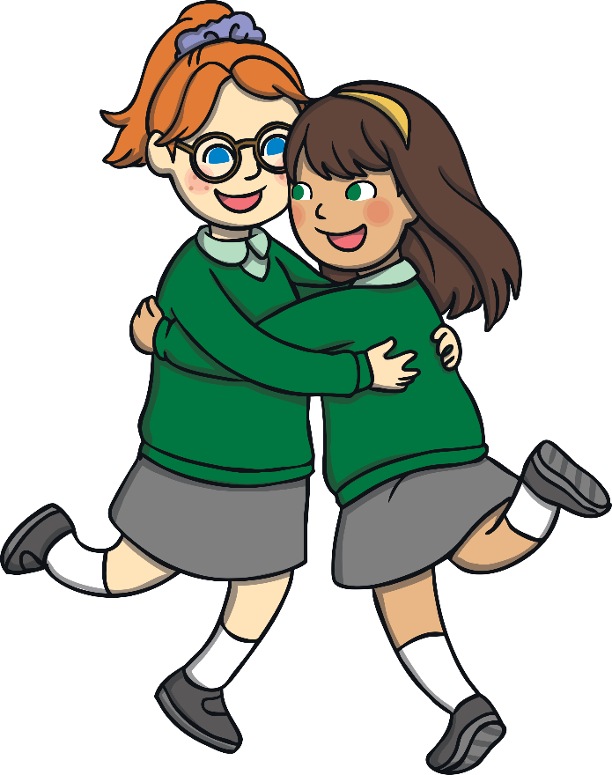
Respect and Tolerance at Northstead
At Northstead we promote mutual respect and tolerance through sharing a culturally diverse community and having opportunities to experience diversity through our curriculum.

Slide 9
The British Values, and our CORE values, help to make us the best we can be?

